Slide 1
Geog 10001: The Geography of Scarcity Water wars
Dr. Brian Cook
School of Geography
brian.cook@unimelb.edu.au

Slide 2
Today we will cover…
Guest commentary by Dr. Jane Dyson
Water
Water wars
Conflicts
The assumptions that frame discussions of water wars (i.e., scarcity).

Slide 3
Final essay and deadline
Final exam.
Changed due date from June 9th to June 16th.
Will allow us to mark the third essay and get you feedback for the final.

Slide 4
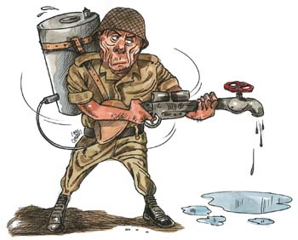
Question to get going…
Do you think we will see a war fought over water in your lifetime?
Of all the water on Earth, only 0.007% is readily available to people through rivers, lakes, and streams. As worldwide populations surge, temperatures rise, climates change and diseases spread, clean water will become ever more essential (and even more rare). … there are few places in the world where a water-poor country is in a military position to attack a water-rich neighbour. Still, many experts believe that as water shortages become increasingly urgent, countries (or at least local communities) will resort to violence” (International Network Archive ND).

Slide 5
REVIEW OF PREVIOUS CLASS

Slide 6
IWRM Definitions
“a process which promotes the coordinated development and management of water, land and related resources in order to maximise the resultant economic and social welfare in an equitable manner without compromising the sustainability of vital ecosystems” (GWP, 2000: 22).
Gleick (2000: 132) identifies as one of the most important failings of twentieth century water management:
“the failure to understand the connection between water and ecological health, and the links between the health of natural ecosystems and human wellbeing”.
IWRM is used to emphasise the integration and balance of social and physical factors while, somewhat hypocritically, also arguing that water is central to social, economic, and environmental sustainability.

Slide 7
The Walsh guest lecture
Thoughts?

Slide 8
WATER WARS

Slide 9
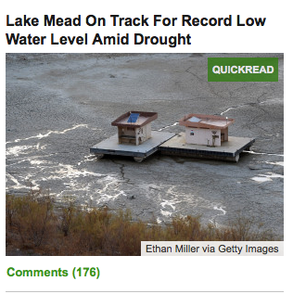
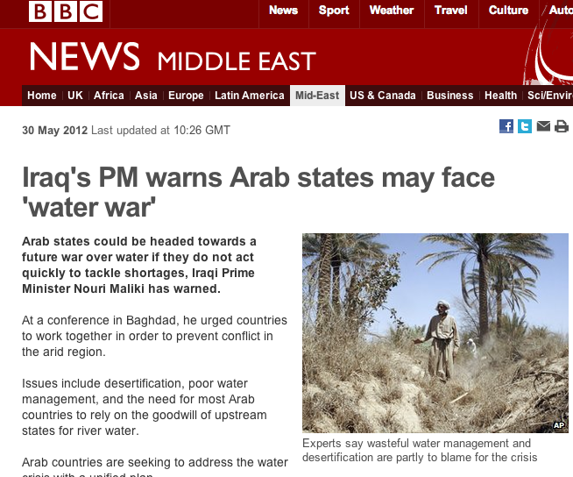
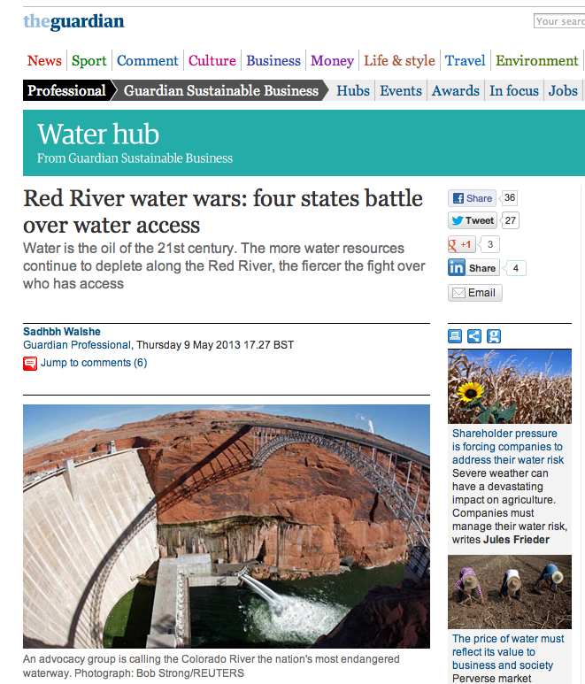
Water wars?
There has been a long-running theme (common within the popular media) that water scarcity leads to war or conflict.

Slide 10
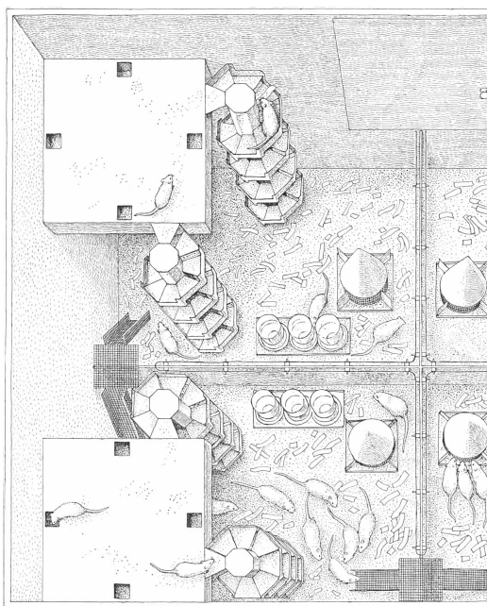
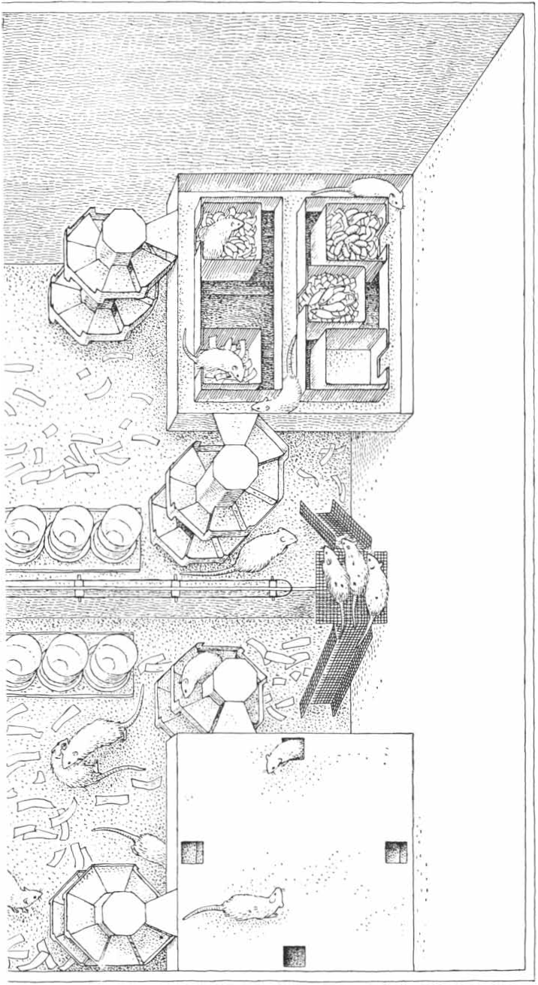
Population Density and Social Pathology
“When a population of laboratory rats is allowed to increase in a confined space, the rats develop acutely abnormal patterns of behavior that can even lead to the extinction of the population” (Calhoun 1962: 139)
Are we like rats?
How much like rats are we?
Can we overcome the factors affecting the rats?

Slide 11
“The consequences of the behavioral pathology we observed were most apparent among the females. Many were unable to carry pregnancy to full term or to survive delivery of their litters if they did. An even greater number, after successfully giving birth, fell short in their maternal functions. Among the males the behavior disturbances ranged from sexual deviation to cannibalism and from frenetic overactivity to a pathological withdrawal from which individuals would emerge to eat, drink and move about only when other members of the community were asleep” (Calhoun 1962: 139).

Slide 12
Homer-Dixon: environmental conflicts
“Homer-Dixon (1994) identifies three ways that humans cause a scarcity of renewable resources. The first is a reduction in the quality and quantity of renewable resources at higher rates, undercutting natural renewal (supply-induced scarcity). The second is increased population growth or per capita consumption (demand-induced scarcity), and the third is unequal resource access (structural scarcity)” (Dwivedi 2004: 51 in Mitchel 2004).
Resource scarcity can be caused by:
Climate change;
Decreased agricultural outputs;
Decreased economic outputs;
Population change (growth, decline, movement);
Institutional disruptions (strikes, disasters)
Social disruptions (war, generational change).

Slide 13
Scarcity based tensions
The environment is the most prominent ‘security’ issue of the 21st century:
Political and strategic impacts of population surges;
Disease vectors and emergence;
Deforestation and soil degradation;
Water depletion and pollution;
Air pollution;
Seal level rise.
“each could lead to mass migrations and increasing group conflicts. Water, he argues, will be in dangerously short supply in areas such as the Middle East, central Asia, and the southwestern US. Water scarcity could cause wars between nations not only over access to fresh water but also over the damming of different parts of rivers” (Dwivedi 2004: 51 in Mitchel 2004).

Slide 14
Water wars?
Aaron Wolf
“This paper investigates the reality of historic water confict and draws lessons for the plausibility of future `water wars'. The datasets of conflict are explored for those related to water - only seven minor skirmishes are found in this century; no war has ever been fought over water. In contrast, 145 water-related treaties were signed in the same period” (Wolf 1998: 251).
“War over water seems neither strategically rational, hydrographically effective, nor economically viable. Shared interests along a waterway seem to consistently outweigh water's conflict-inducing characteristics. Furthermore, once cooperative water regimes are established through treaty, they turn out to be impressively resilient over time, even between otherwise hostile riparians and even as conflict is waged over other issues. These patterns suggest that the more valuable lesson of international water is as are sources whose characteristics tend to induce cooperation and incite violence only in the exception” (Wolf 1998: 251).

Slide 15
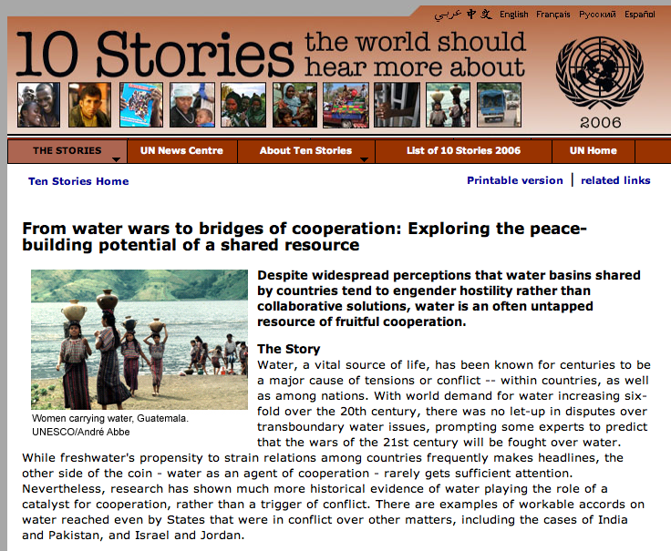
“While it is true that water disputes have taken a military turn on at least seventeen occasions during the period 1900–2001, the last all-out war over water took place 4,500 years ago — between the city-states of Lagash and Umma. In comparison, thousands of water agreements have been concluded, the oldest dating back to 3100 BCE. Consequently, as Wolf and Hamner have noted, “the more valuable lesson of international water is as a resource whose characteristics tend to induce cooperation, and incite violence only in the exception” (Dinar 2009: 109).

Slide 16
CASE STUDY: ASIA

Slide 17
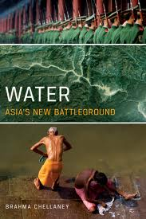
Asian Water
“Water scarcity is set to become Asia’s defining crisis by midcentury, creating obstacles in its path of continued rapid economic growth and stoking new interstate tensions over shared river basin resources” (Chellany 2011: 1).
“Water scarcity now affects more than two-fifths of the people on Earth, but by 2025, two-thirds of the global population is likely to be living in water-scarce or water-stressed conditions. And the majority of the world’s people living in water-related despair will be in Asia” (Chellany 2011: 8).

Slide 18
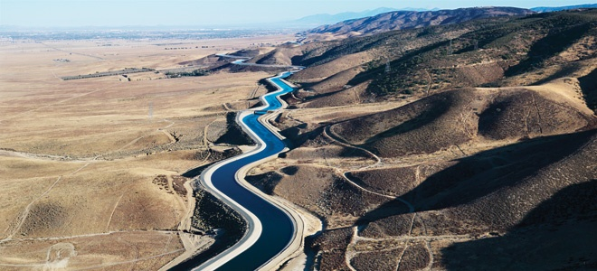
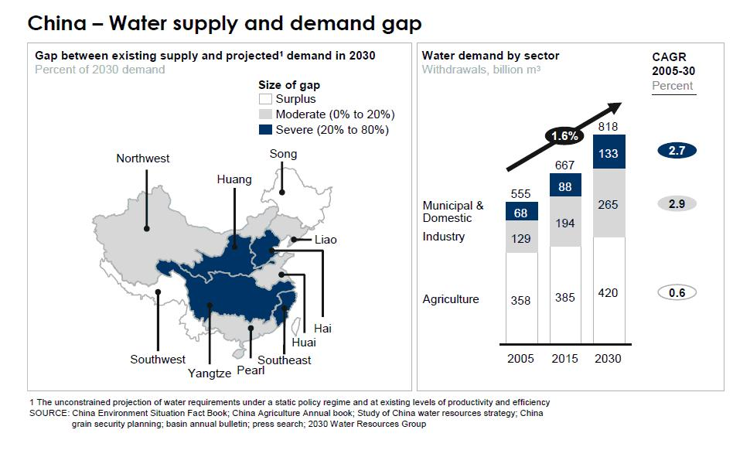
Water in China

Slide 19
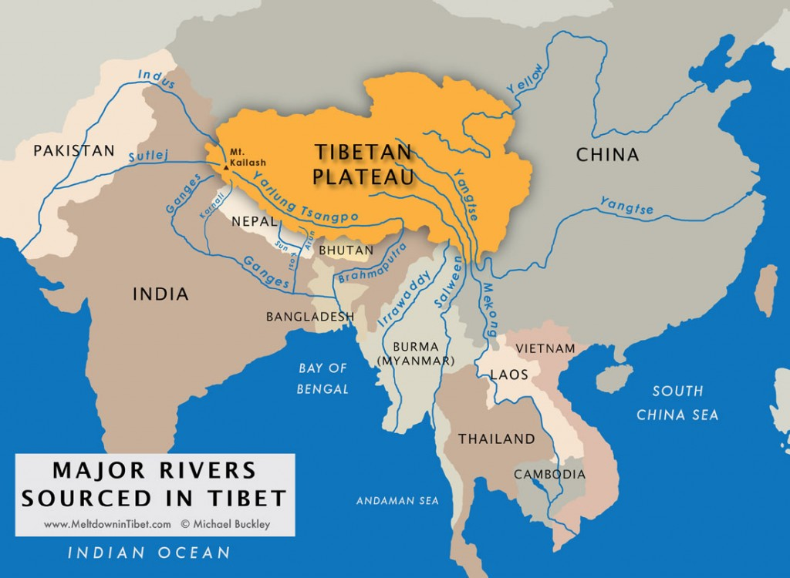
Conflict in Asia: China at Heart
“The big issue in Asia, apart from climate change, is whether China will exploit its control of the Tibetan Plateau to increasingly siphon off for its own use the waters of the international rivers that are the lifeblood of the countries located in a contiguous arc from Vietnam to Afghanistan” (Chellaney 2011: 15).

Slide 20
SUMMARY & CONCLUSION

Slide 21
Key point 1
Hydro-Hazards
It looks as though water (scarcity) is the basis for increasing conflicts, but in a ‘cold war’ sort of way.
China’s control of the Tibetan Plateau.

Slide 22
Next Class
Virtual water
Conclusion and final exam question

Slide 23
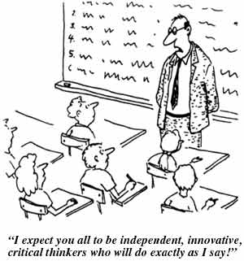
Questions or Concerns
Questions?

Slide 24
Sources & Further Reading
Allan, J. A. 2011. Virtual Water: tackling the threat to our planet's most precious resource. London, I.B.Tauris.
Amery, H. A. and Wolf, A. T. 2000. Water in the Middle East: a geography of peace, University of Texas Press Austin.
Brock, L., Homer-Dixon, T., Perelet, R., Vlachos, E. and Gleditsch, N. 1997. Conflict and the Environment, Springer.
Calhoun, J. B. 1962. Population density and social pathology. Scientific American.
Chapagain, A. K. and Hoekstra, A. Y. 2008. The global component of freshwater demand and supply: an assessment of virtual water flows between nations as a result of trade in agricultural and industrial products. Water International 33(1): 19-32.
Chellaney, B. 2011. Water: Asia's New Battleground. Washington D.C., Georgetown University Press.
Gleick, P. H. 1993. WATER AND CONFLICT - FRESH-WATER RESOURCES AND INTERNATIONAL SECURITY. International Security 18(1): 79-112.
--- 1998. Water in crisis: Paths to sustainable water use. Ecological Applications 8(3): 571-579.
--- 2000. The changing water paradigm: A look at twenty-first century water resources development. Water International 25(1): 127-138.
--- 2002. Water management - Soft water paths. Nature 418(6896): 373-373.
Gleick, P. H. and Lane, J. 2005. Large international water meetings: Time for a reappraisal - A water forum contribution. Water International 30(3): 410-414.
Hoekstra, A. Y. and Hung, P. Q. 2005. Globalisation of water resources: international virtual water flows in relation to crop trade. Global Environmental Change-Human And Policy Dimensions 15(1): 45-56.
Homer-Dixon, T.F. (1994) Environmental scarcities and violent conflict: evidence from cases. International Security 19, 5-40.
Homer-Dixon, T.F. (2010) Environment, scarcity, and violence. Princeton University Press.
Ma, J., Hoekstra, A. Y., Wang, H., Chapagain, A. K. and Wang, D. 2006. Virtual versus real water transfers within China. Philosophical Transactions of the Royal Society B-Biological Sciences 361(1469): 835-842.
Mitchell, B. (2013) Resource & Environmental Management. Routledge.
Nonetheless, I. (2012) What Should Be Integrated?
Seekell, D. A., D'Odorico, P. and Pace, M. L. 2011. Virtual water transfers unlikely to redress inequality in global water use. Environmental Research Letters 6(2).
Wolf, A. T. 1998. Conflict and cooperation along international waterways. Water Policy 1(2): 251-265.
Wolf, A. T. 1999. "Water wars" and water reality: Conflict and cooperation along international waterways. Environmental Change, Adaptation, And Security 65: 251-265.

